Slide 1

7th Grade Accelerated Math
Unit 2, Lesson 1 Square Values Volume 1, pg. 63

Slide 2


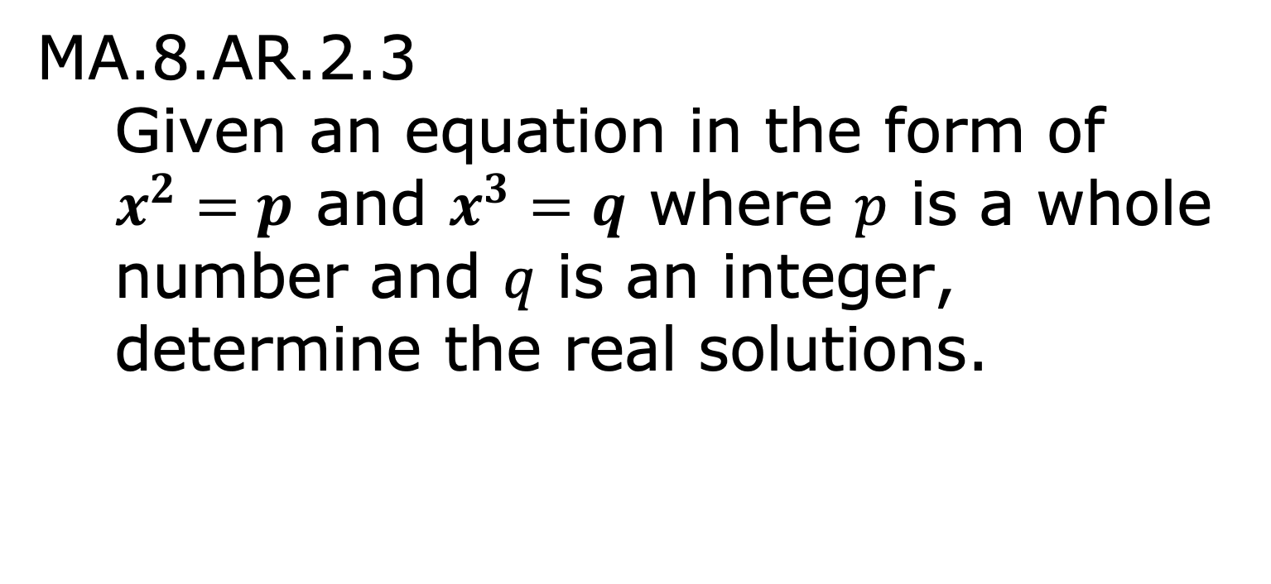
Benchmark
MA.8.AR.2.3
Given an equation in the form of $x^{2}=p$ and $x^{3}=q$ where 𝑝 is a whole number and 𝑞 is an integer, determine the real solutions.
volume 1, pg. 63

Slide 3
Integrated Mathematical Thinking and Reasoning Standards
MA.K12.MTR.1.1 Actively participate in effortful learning both individually and collectively.
MA.K12.MTR.2.1 Demonstrate understanding by representing problems in multiple ways.
MA.K12.MTR.4.1 Engage in discussions that reflect on the mathematical thinking of self and others.
MA.K12.MTR.5.1 Use patterns and structure to help understand and connect mathematical concepts.
volume 1, pg. 63

Slide 4

Learning Target
I can use multiple representations to explore square values.
volume 1, pg. 63

Slide 5

Warm-Up
volume 1, pg. 63

Slide 6
2.1.1 Warm-Up: Reflecting On Learning
Learning something new can sometimes be challenging, but the challenges are part of what leads to success.
“Failure is not the opposite of success. It is part of
success.” -Arianna Huffington
What would you want your teacher to say to you when they see you taking a risk, trying hard, or pushing through mistakes to learn something new?
Describe how it feels when you learn or accomplish something that is really challenging.
volume 1, pg. 63

Slide 7

Exploration
volume 1, pg. 64

Slide 8

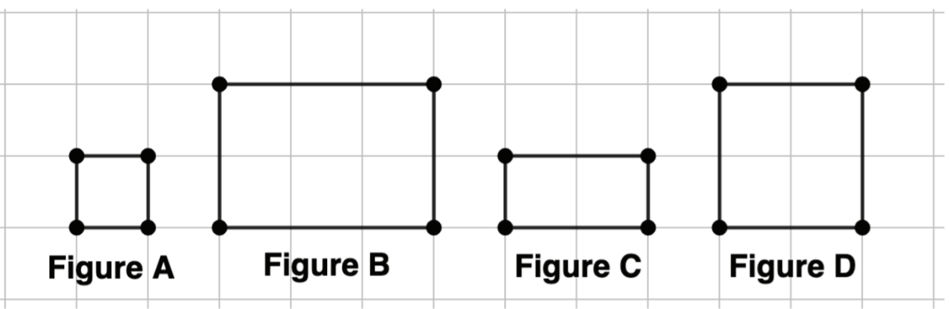
2.1.2 Exploration: Area of Squares
Complete the following with your partner.
Four figures are shown on the grid, where each gridline is 1 unit.
volume 1, pg. 64

Slide 9
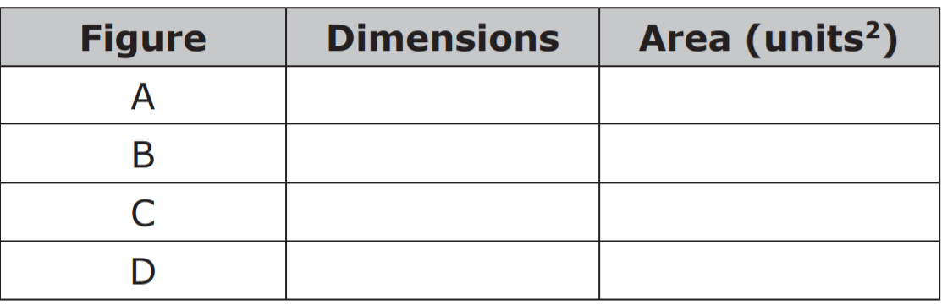
Find the dimensions and area of each figure.
All of the figures above are rectangles. Explain, using the dimensions, which of the shapes are also squares.
volume 1, pg. 64

Slide 10
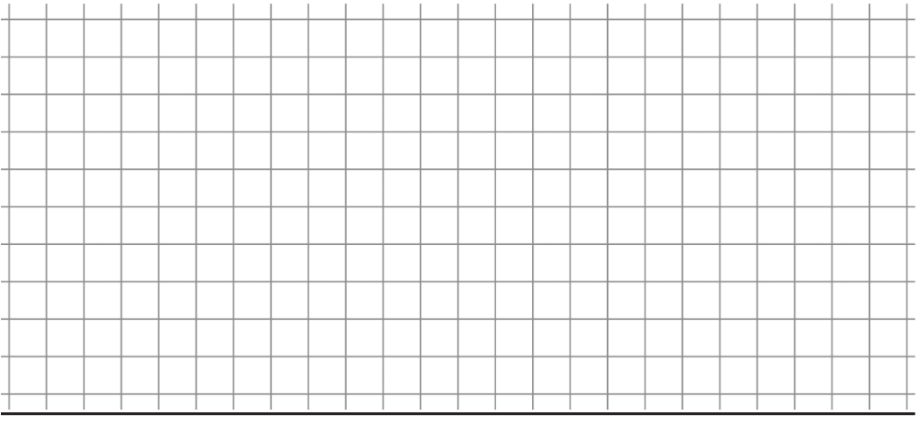
With your partner, create squares whose areas range from 1 to 25 square units. Create as many as possible on the grid paper below. Each gridline has a length of 1 unit.
For each square, label the length and the width, along with the area inside.
Form a group with another pair of partners.
Compare the squares each group created and, if
necessary, add any squares to your grid.
volume 1, pg. 64

Slide 11
Alicia says, “1 squared is 1 and 2 squared is 4.” Explain what you think it means to square a number.
volume 1, pg. 64

Slide 12

Bring It Together
volume 1, pg. 65

Slide 13

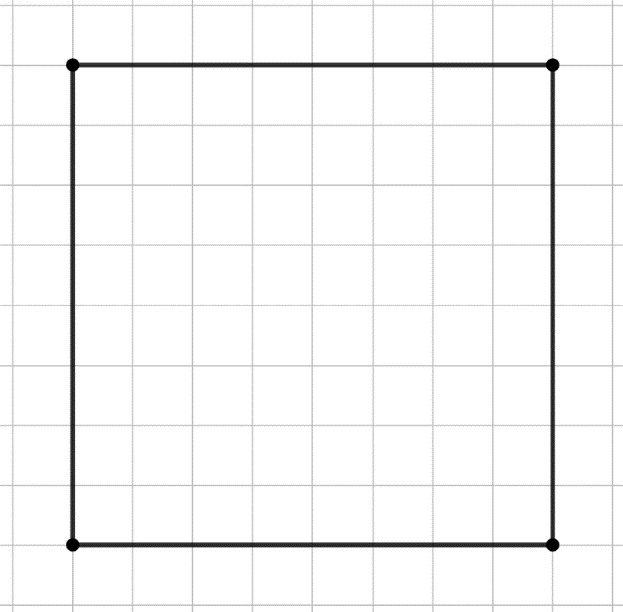
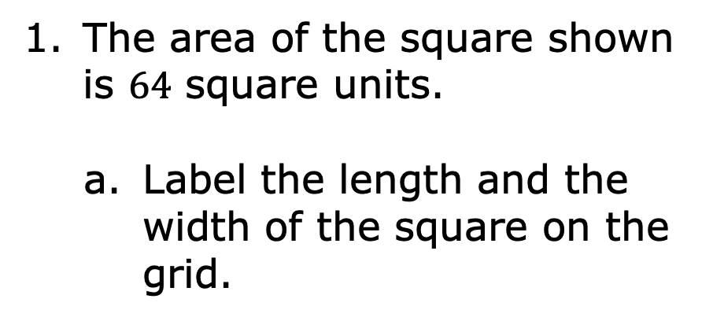
2.1.3 Bring It Together: Area of Squares
The area of the square shown is $64$ square units.
Label the length and the width of the square on the grid.
volume 1, pg. 65

Slide 14
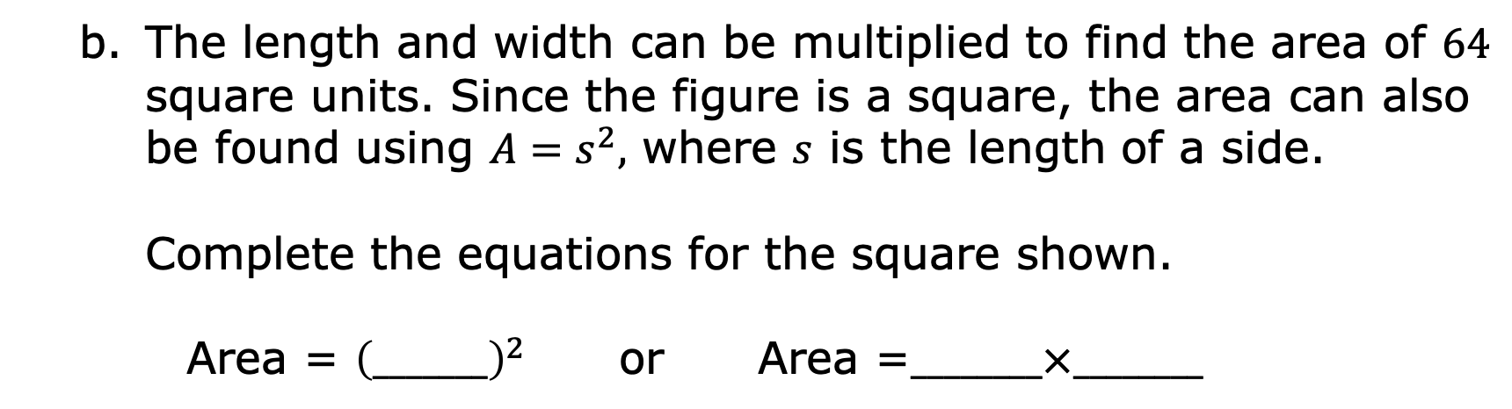
The length and width can be multiplied to find the area of $64$ square units. Since the figure is a square, the area can also be found using $A=s^{2},$ where $s$ is the length of a side.
Complete the equations for the square shown.
Area = ${\left(_______\right)}^{2}$ or Area =$________×________$
volume 1, pg. 65

Slide 15

Consider a square with an area of $100$ units².
What is the length of each side?
Explain how you determined the length.
volume 1, pg. 65

Slide 16

Consider a rectangle with an area of $8$ square units.
Use the grid to draw all of the possible rectangles with an area of $8$ square units.
Explain whether it is possible to have a square with an area of $8$ square units.
volume 1, pg. 65

Slide 17
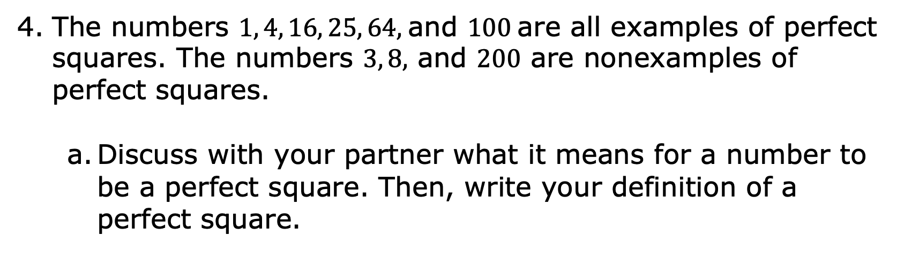
The numbers $1, 4, 16, 25, 64,$and $100$are all examples of perfect squares. The numbers $3, 8,$ and $200$ are nonexamples of perfect squares.
Discuss with your partner what it means for a number to be a perfect square. Then, write your definition of a perfect square.
volume 1, pg. 66

Slide 18
Ask two other pairs of partners the definition they wrote. Listen to their definition and write a summary. You are the only person who should write in the first column of the table. Have the person initial next to your summary stating that your summary was accurate.
Review the definitions with your partner and make any necessary adjustments to your own definition.
My Summary of the Definition of a Perfect Square | Initials
volume 1, pg. 66

Slide 19
Exploration
volume 1, pg. 66

Slide 20
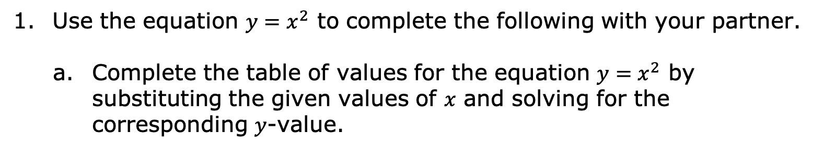
2.1.4 Exploration: Square Values on the Coordinate Plane
Use the equation $y=x^{2}$ to complete the following with your partner.
Complete the table of values for the equation $y=x^{2}$ by substituting the given values of $x$ and solving for the corresponding $y$-value.
volume 1, pg. 66

Slide 21
Discuss with your partner why the 𝑦-values are all perfect squares. Summarize your discussion.
volume 1, pg. 66

Slide 22
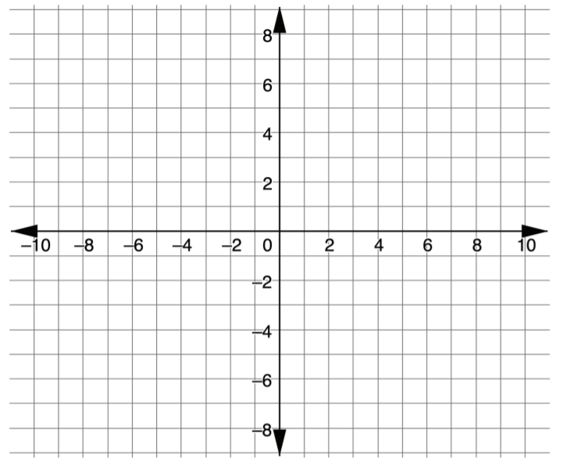
Plot the coordinates on the grid shown.
volume 1, pg. 67

Slide 23
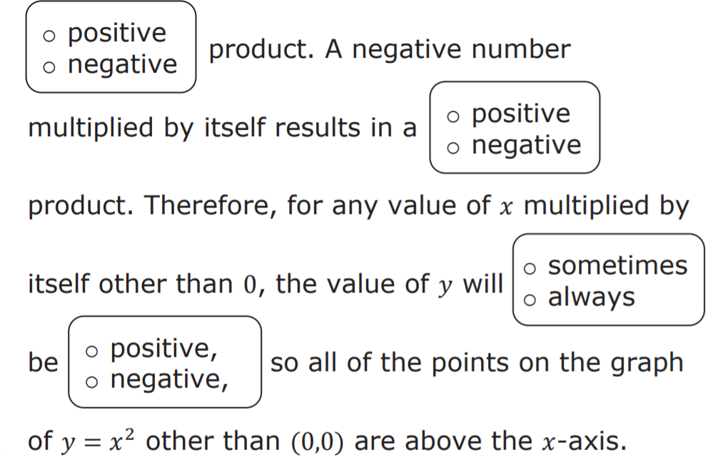

The graph of $y=x^{2}$does not go below the $x$-axis. Complete the statements. A positive number multiplied by itself results in a
volume 1, pg. 67

Slide 24
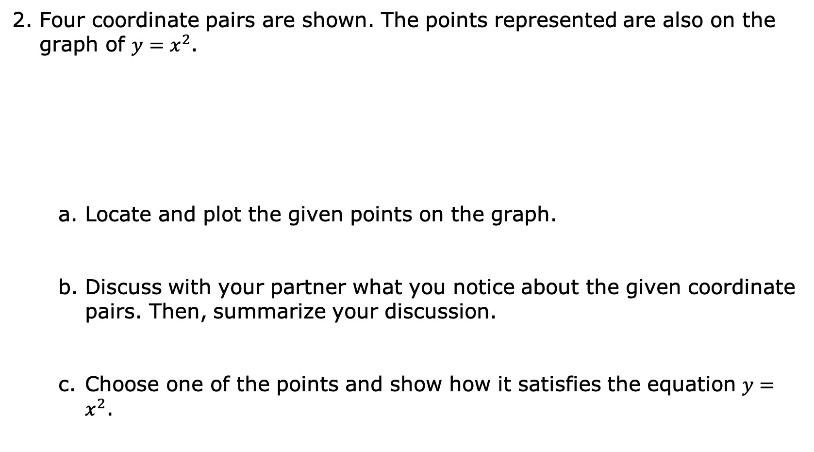
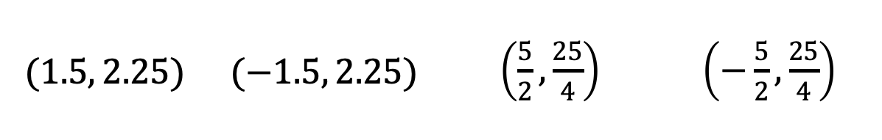
Four coordinate pairs are shown. The points represented are also on the graph of $y=x^{2}$.
Locate and plot the given points on the graph.
Discuss with your partner what you notice about the given coordinate pairs. Then, summarize your discussion.
Choose one of the points and show how it satisfies the equation $y=x^{2}$.
$$(1.5, 2.25)$$ | $$(−1.5, 2.25)$$ | $\left(\frac{5}{2},\frac{25}{4}\right)$ | $\left(−\frac{5}{2}, \frac{25}{4}\right)$
volume 1, pg. 67

Slide 25

Wrap-Up
volume 1, pg. 68

Slide 26
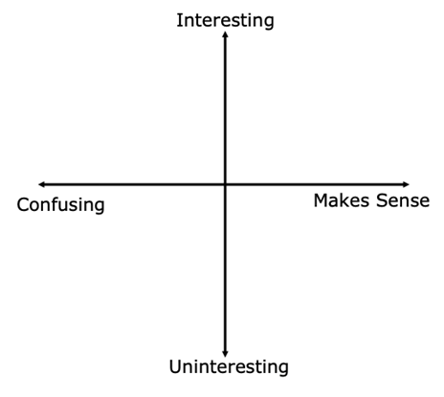
2.1.5 Wrap-Up: Reflection
Plot a point on the grid below to indicate your level of interest and understanding of today’s learning targets.
Write one question you have about square values after today’s lesson.
volume 1, pg. 68

